Slide 1
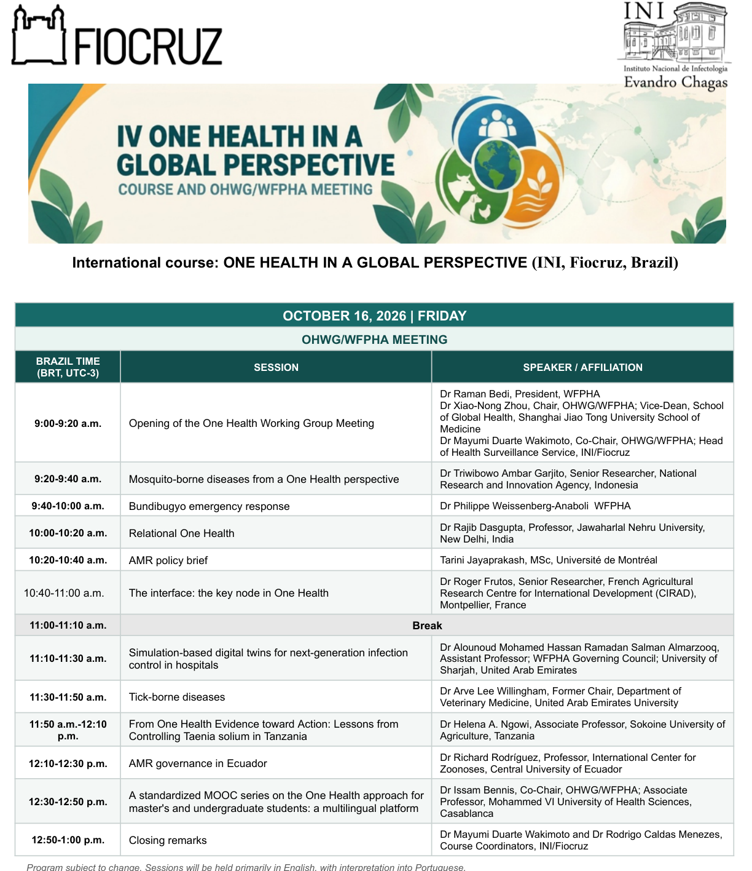
IV ONE HEALTH IN A GLOBAL PERSPECTIVE
First presented at the OHWG/WFPHA Meeting, INI/Fiocruz, Brazil
Friday 16 October 2026
12:30–12:50 BRT
A standardized MOOC series on the One Health approach for master’s and undergraduate students: a multilingual platform
Dr Issam Bennis, Co-Chair, OHWG/WFPHA · UM6SS, Casablanca
Notes:
This presentation was first given at the OHWG/WFPHA meeting hosted by INI/Fiocruz in Brazil. It explains why the course Introduction to Environmental Health and One Health is the pilot of a multilingual One Health MOOC series.

Slide 2
HUB ONE HEALTH AFRIQUE · INTELIGIS – UM6SS
A standardized MOOC series on the One Health approach for master’s and undergraduate students: a multilingual platform
AI in the service of global One Health education
Dr Issam Bennis
Co-Chair, OHWG/WFPHA · Associate Professor, Mohammed VI University of Health Sciences (UM6SS), Casablanca
mooc.inteligisum6ss.com
Notes:
Can human health still be studied in isolation? No. So how do we train One Health professionals everywhere, to the same standard?

Slide 3
THE CHALLENGE
One Health is a global emergency — yet it is taught differently everywhere
Urgency
Divergence
The need
Pandemics, climate change and antimicrobial resistance cross every border.
The same approach is interpreted and taught differently from one region to another.
One shared core of competencies, identical for every learner, wherever they study.
Hub One Health Afrique · INTELIGIS – UM6SS · onehealthafrique.com/mooc
Notes:
One Health is urgent, but it is taught differently in every country. Students need one shared core of competencies.

Slide 4
THE FOUNDATION
mooc.inteligisum6ss.com: one high-quality standard, built first in French
Open edX platform
Expert-designed content
Run by INTELIGIS – UM6SS for the Hub One Health Afrique: self-paced courses, graded quizzes, certificates.
Built on WHO and UN references, with a common case study running through the whole course.
Competencies, not just content
Designed to travel
Quizzes after each session, a final exam and an expert-graded certification assignment.
A standard is only global if every learner can read it — in their own language.
Hub One Health Afrique · INTELIGIS – UM6SS · onehealthafrique.com/mooc
Notes:
We built mooc.inteligisum6ss.com, an Open edX platform, and first created a rigorous standard in French.

Slide 5
WHY THIS COURSE IS OUR EXAMPLE
Introduction to Environmental Health and One Health
Non-negotiable content
65
68
1. Foundations of environmental health
2. Toxicology and risk assessment
3. Water, air and food
4. Environment, climate, law and justice
5. The One Health approach
learning units
content pages
40
80%
One fictional territory, Wadi Nour, links every concept to real exposures — a case that works in any country and any language.
quiz and exam questions
score for the certificate
Hub One Health Afrique · INTELIGIS – UM6SS · onehealthafrique.com/mooc
Notes:
Our pilot: Introduction to Environmental Health and One Health. Five chapters, 65 units, 40 questions, a certificate at 80%. Its common case study, Wadi Nour, works in any language.

Slide 6
THE LANGUAGE WALL
Recreating a course in another language used to take months
Classic route
AI-assisted route
Translate every page, redraw every diagram, rebuild every quiz, re-test the whole course: months per language, with drift from the original.
Generative AI translates with a domain glossary, redraws diagrams and rebuilds the course; automated checks prove it is the same course. Hours, not months.
Hub One Health Afrique · INTELIGIS – UM6SS · onehealthafrique.com/mooc
Notes:
Translating a full course used to take months per language. With generative AI, it takes hours.

Slide 7
ONLINE NOW
One standard. Five languages.
FR
EN
PT-BR
ES
AR
Introduction à la santé environnementale et One Health
Introduction to Environmental Health and One Health
Introdução à Saúde Ambiental e One Health
Introducción a la Salud Ambiental y One Health
مدخل إلى الصحة البيئية والصحة الواحدة
English, Brazilian Portuguese, Spanish and Arabic were produced, checked and published within a single day (16 October 2026).
onehealthafrique.com/mooc · mooc.inteligisum6ss.com
Notes:
Today the same course is online in French, English, Brazilian Portuguese, Spanish and Arabic. The four new versions were produced, checked and published in a single day.

Slide 8
HOW WE KEEP THE SCIENCE IDENTICAL
Cloning the learning experience, with built-in checks
1
2
3
4
5
Export
Translate
Verify
Review
Publish
The validated French course is the single source.
AI with a WHO-aligned glossary for each language.
Same structure, same answer keys and grading, no text left untranslated.
Subject-matter experts review before opening.
One parallel course per language, same certificate rules.
Hub One Health Afrique · INTELIGIS – UM6SS · onehealthafrique.com/mooc
Notes:
The science does not change: automated checks confirm the same structure, the same answers and the same grading in every language, and experts review the result.

Slide 9
ROADMAP
One standard, every language
ONLINE TODAY
NEXT
French · English · Brazilian Portuguese · Spanish · Arabic
Chinese
Then the rest of the series: each new One Health MOOC is built once and released in every language.
Hub One Health Afrique · INTELIGIS – UM6SS · onehealthafrique.com/mooc
Notes:
Five languages are online today; Chinese is next. The same pipeline then applies to every new course of the series.

Slide 10
YOUR ADVANTAGE
A common scientific language for your future networks
Interoperability
Shared vocabulary
Collaboration
Learners certified on the same bases in Casablanca, Rio or Beijing.
The same concepts, methods and case study, in your own language.
A foundation for international research teams and joint training.
Hub One Health Afrique · INTELIGIS – UM6SS · onehealthafrique.com/mooc
Notes:
Students in Casablanca, Rio or Beijing get the same certification: a common scientific language for future collaboration.

Slide 11
EXPLORE THE COURSE
The same course in every language, in four steps
1 · Choose a language
2 · Same unit, side by side
onehealthafrique.com/mooc → FR, EN, PT, ES or AR
Wadi Nour case and illustrated WHO units
3 · Same interactivity
4 · Same assessment
“The dose makes the poison” simulator
Same quiz, same answer key, same 80% threshold
Notes:
Choose your language on the Hub website, open the same unit in two languages, try the dose–response simulator and compare the quizzes: questions and answer keys are identical.

Slide 12
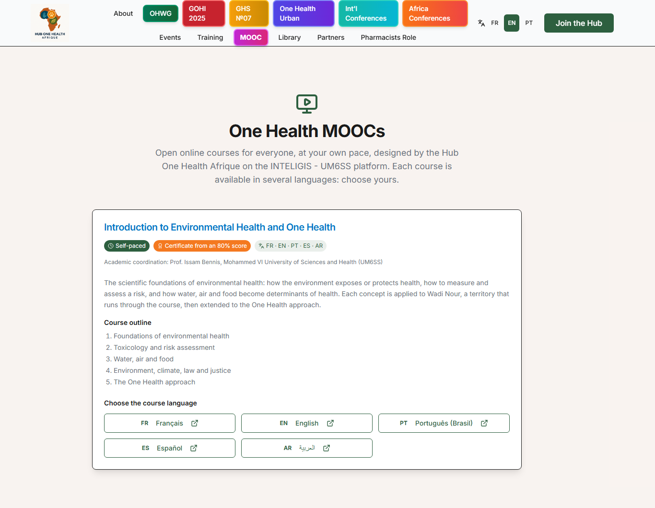
STEP 1 · THE HUB WEBSITE
One page, five languages
onehealthafrique.com/mooc
The course presented in the visitor’s language
One click to the French, English, Portuguese, Spanish or Arabic version
The MOOC badge in the menu leads here
Hub One Health Afrique · INTELIGIS – UM6SS · onehealthafrique.com/mooc
Notes:
Everything starts on onehealthafrique.com/mooc: the course is presented in the visitor’s language, and one click opens any of the five versions.

Slide 13
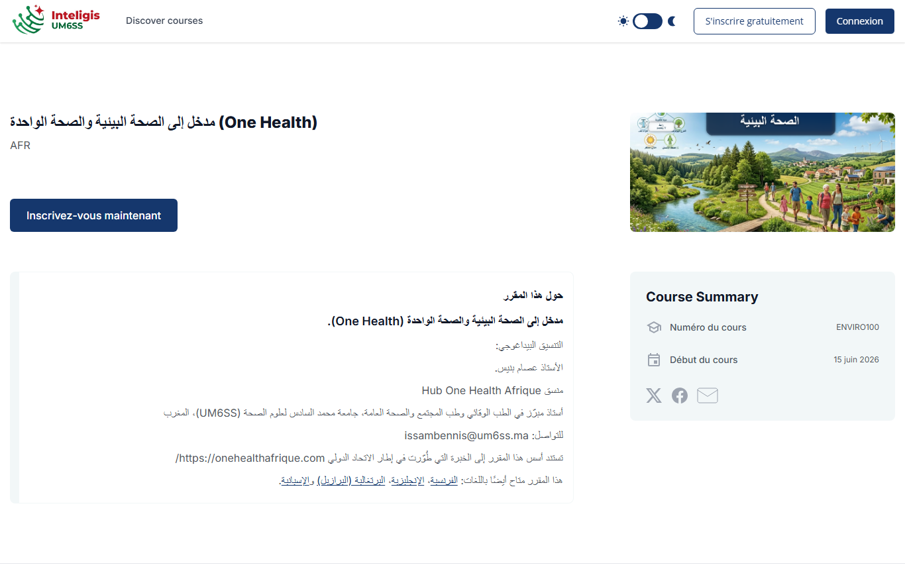
STEP 2 · THE COURSE IN YOUR LANGUAGE
Here in Arabic: translated, right to left, ready to enrol
mooc.inteligisum6ss.com
Translated title, text and course image
Same structure and certificate rules as the French original
Enrolment in one click
Hub One Health Afrique · INTELIGIS – UM6SS · onehealthafrique.com/mooc
Notes:
Here is the Arabic version: translated title, text and course image, right-to-left layout, and the same structure and certification rules as the original.

Slide 14
One Health education no longer has language borders
Try the pilot
Join us
Introduction to Environmental Health and One Health — in French, English, Portuguese, Spanish or Arabic
Partner institutions and expert reviewers for the next languages and courses
onehealthafrique.com/mooc · mooc.inteligisum6ss.com
Dr Issam Bennis · Co-Chair, OHWG/WFPHA · UM6SS, Casablanca
Notes:
One Health education no longer has language borders. Try the pilot and join us as partners and reviewers. Thank you — obrigado.

